Slide 1

Using ML Model to Predict Most Likely product to be Sold on E-commerce Platform
GROUP-12
PREETAM SHANKAR MALLA (22)
NAGASHEKAR VANAPALLI (35)

Slide 2
PREFACE
E-commerce platforms aim to enhance user experience and increase sales.
Personalized product recommendations are a key area for improvement.
Machine learning techniques can be used to analyze customer transaction data and identify patterns and preferences.
The information derived from data analysis can be used to generate the most likely category of products and the likely product that a user is most likely to purchase.
Personalized product recommendations can increase the likelihood of a sale and improve the user experience.
The project aims to develop a model that leverages customer transaction data and machine learning techniques to provide personalized product recommendations.
The ultimate goal is to increase sales and customer satisfaction for the e-commerce platform.

Slide 3
DATASET
We have worked on a dataset from Instacart, an E-commerce company.
We discovered this dataset on Kaggle.
https://www.kaggle.com/datasets/yasserh/instacart-online-grocery-basket-analysis-dataset?resource=download&select=products.csv

Slide 4
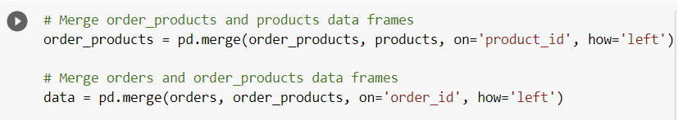
Merging the Data
We merged two Pandas data frames, order_products and products, based on a common column product_id. The resulting merged data frame is then merged with another data frame orders, based on a common column order_id. The resulting merged data frame is stored in a variable data.

Slide 5
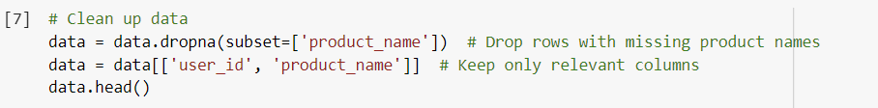
Cleaning the Data
We are performing data cleaning on the data DataFrame by dropping rows that have missing values in the 'product_name' column using the dropna() method. The resulting DataFrame is assigned back to the data variable.
We are selecting only two relevant columns, 'user_id' and 'product_name', from the DataFrame using the indexing operator [] and assigning the resulting DataFrame back to the data variable.

Slide 6
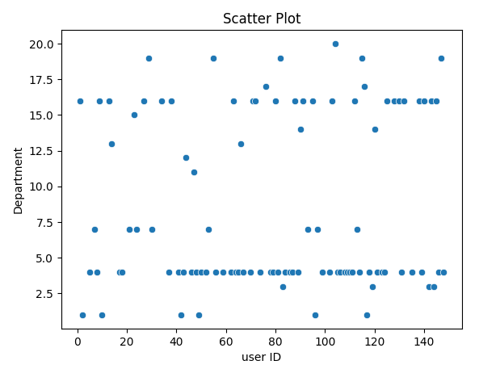
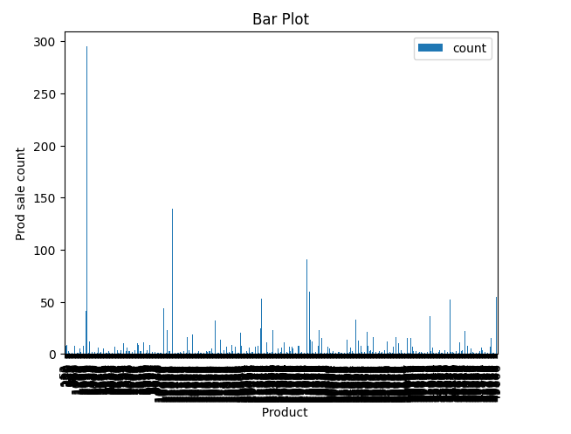
Feature Engineering

Slide 7
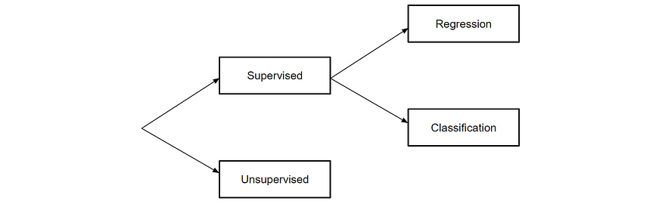
Machine Learning Model

Slide 8
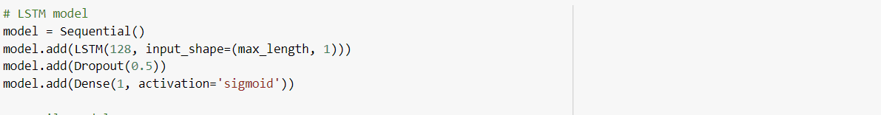
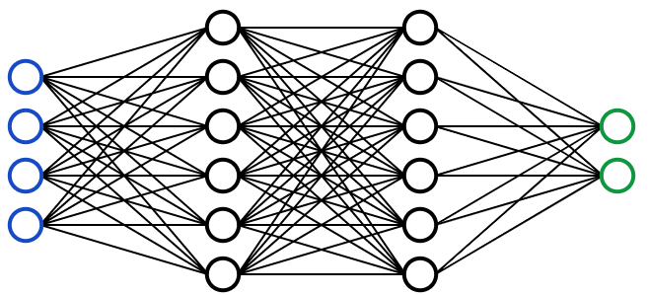
Machine Learning Model

Slide 9
Machine Learning Model
We have used the LSTM (Long Short Term Memory) model for binary Classification.
There are many approaches that can be used one such approach is to use a Long Short-Term memory(LSTM) network, this is a type of Recurrent Neural Network(RNN).
The LSTM network is trained on a series of dataset by feeding it input data one time step at a time and using the previous time steps to predict the next time step.

Slide 10
Code Walk Through

Slide 11
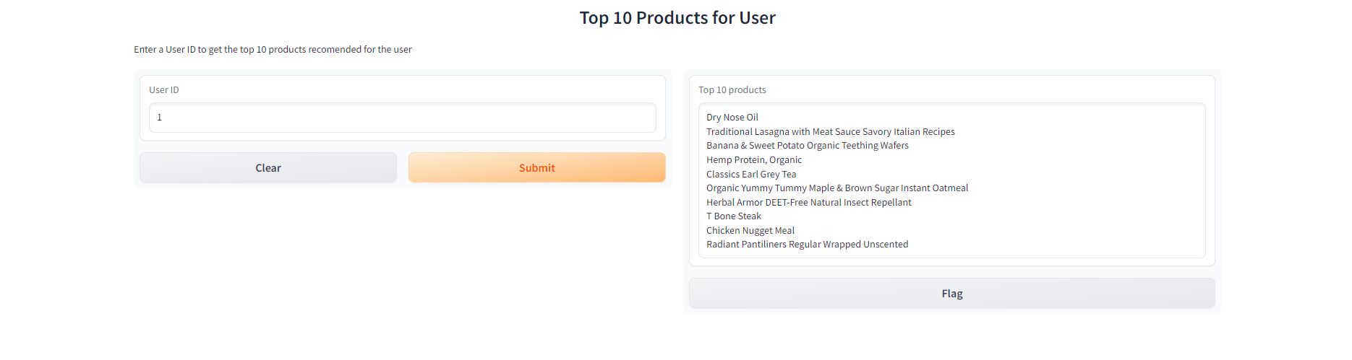
User Interface

Slide 12
Question ???
Thank you…

